Slide 1



DOWNLOAD
CMDR.ZIP

Slide 2
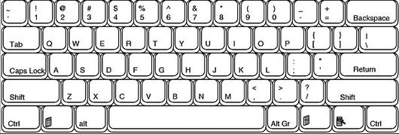

Slide 3
